Slide 1
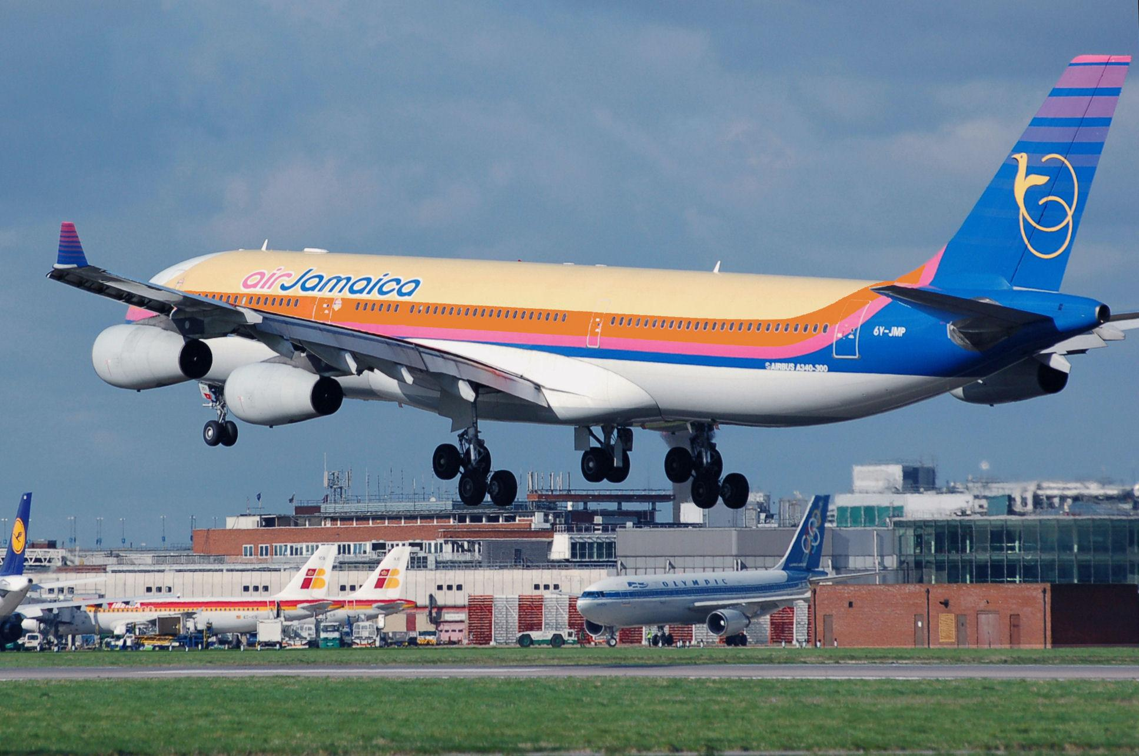
TRAVEL PACK
Prepared For:
EBERECHUKWU CHARITY
Vacation to montego bay Jamaica
December 15 2024- December 22 2024

Slide 2
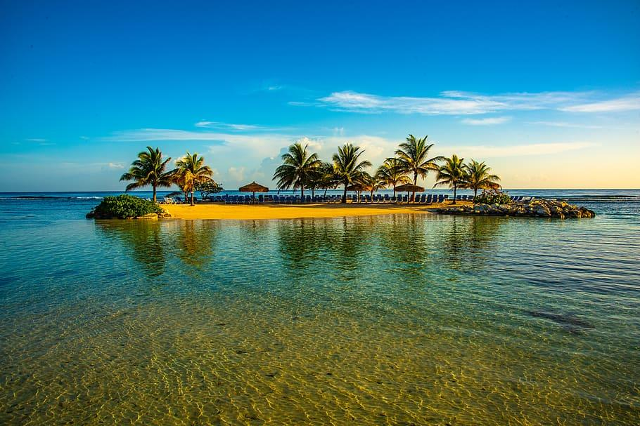
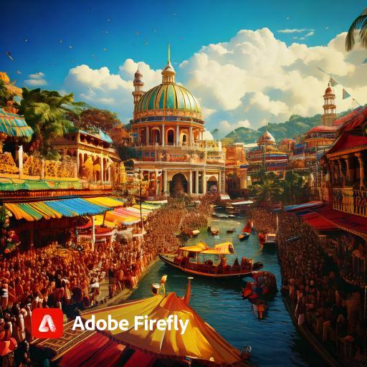

Table of contents
Entry/Exit requirements
Itinerary
Etiquette and cultural expectations
Event and hotel informations
Budget

Slide 3
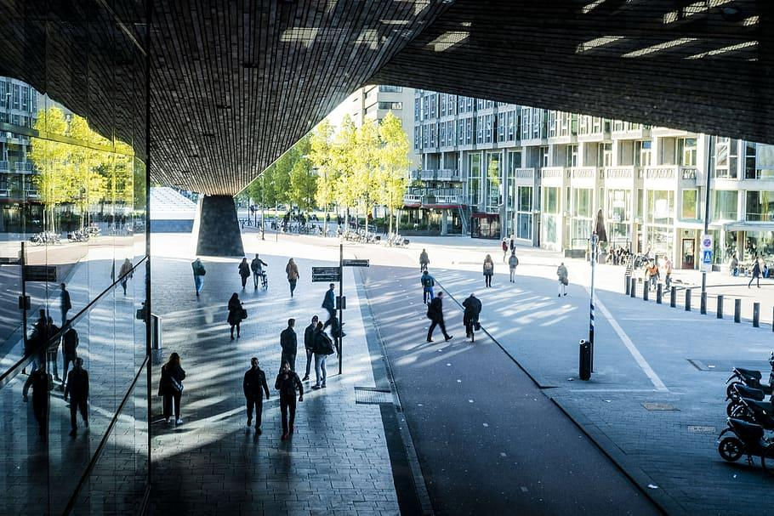

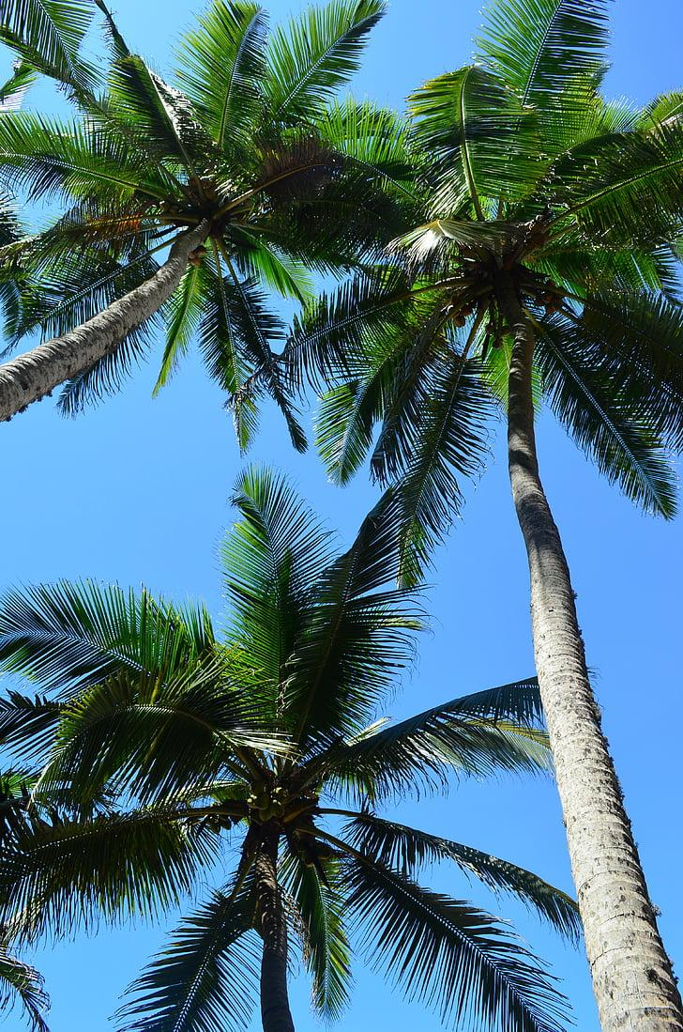
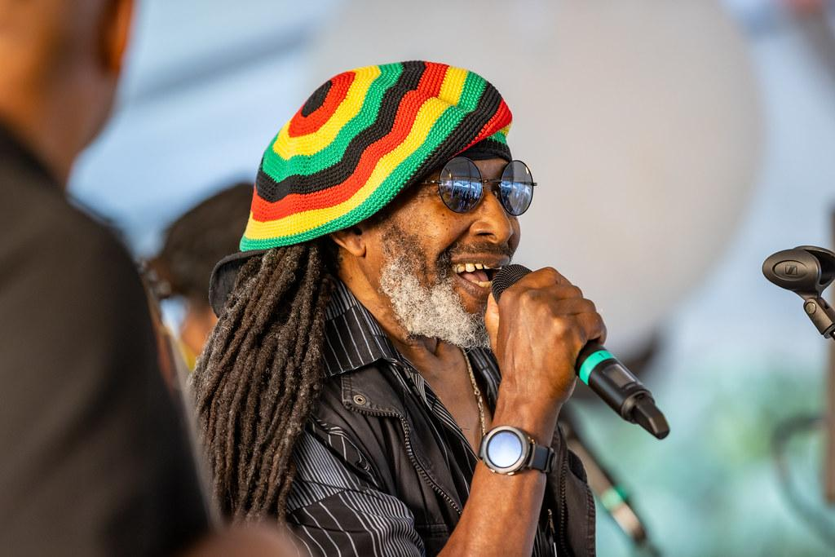
Entry/Exit information
Entry/Exit information
ENTRY
EXIT
PASSPORT VALIDITY: Must be valid at the time of entry and exit
ONE PASSPORT SIZE PHOTOGRAPH
COMPLETED VISA APPLICATION FORM
Visa country embassy
J SIGNATURE REQUIRED
RETURN TICKET
Return Ticket Letter from Ministry of Labour, Jamaica
passport
Travel documents
Travel documents
JAMAICAN
https://www.visitjamaica.com/plan-your-adventure/travel-tips/entry-requirements/
https://www.visitjamaica.com/plan-your-adventure/travel-tips/entry-requirements/

Slide 4
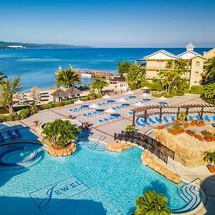
Documentation requirements
PASSPORT VALIDITY: Must be valid at the time of entry and exit
ONE PASSPORT SIZE PHOTOGRAPH
COMPLETED VISA APPLICATION FORM
J SIGNATURE REQUIRED
RETURN TICKET
https://www.visitjamaica.com/plan-your-adventure/travel-tips/entry-requirements/

Slide 5
TRAVEL ITINERARY

Slide 6

ITINERARY
DEPARTING FLIGHT
DATE | Depart- Location | DEPART TIME | Airline | Confirm # | Flight | Arrival location | Arrival time | More infor
SUN.15 DECEMBER | LAGOS, Murtala Muhammed airport | 8AM UTC | KLM | KLM 246-LOS-JAM | A1B2C3 KLM | SANGSTER INT’L AIRPORT | 5AM UTC

Slide 7

RETURNING FLIGHT
DATE | Depart- Location | DEPART TIME | Airline | Confirm # | Flight | Arrival location | Arrival time | More info
SUN.22 DECEMBER | SANGSTER INT’L AIRPORT | 8AM UTC | KLM | KLM026-JAM-LOS | KLM B3B2C3 | MUTULA MUMMAHMED AIRPORT | 5AM UTC

Slide 8
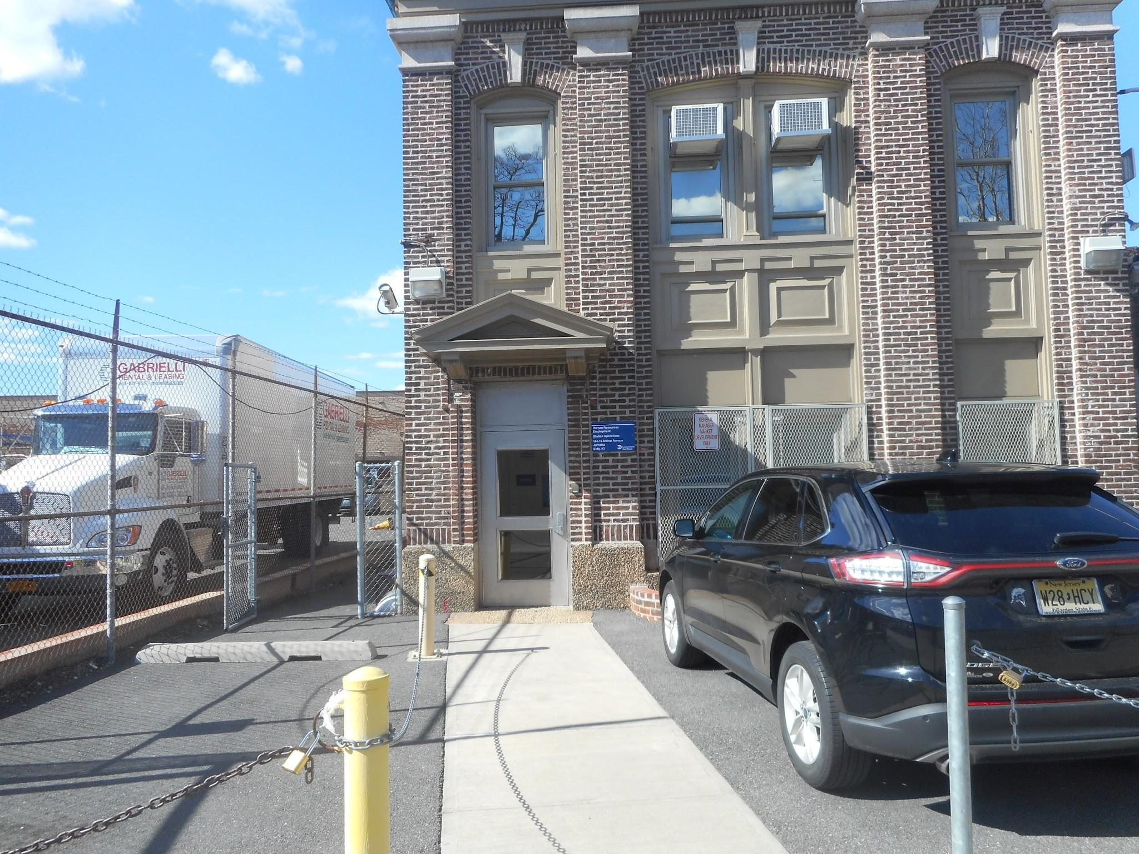
GROUND TRANSPORTATION AT DESTINATION
DATE | TIME | COMPANY | MEET UP LOCATION | CONFIRM | PICK UP TIME | RETURN DATE | RETURN TIME | MORE INFO
MON.16 DECEMBER | 5:30AM UTC | Timeless Mobay rentals | SECRETS WILD ORCHID | 478654 JAM6 | 12PM UTC | 21 December | 6pm UTC

Slide 9
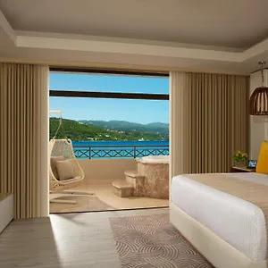
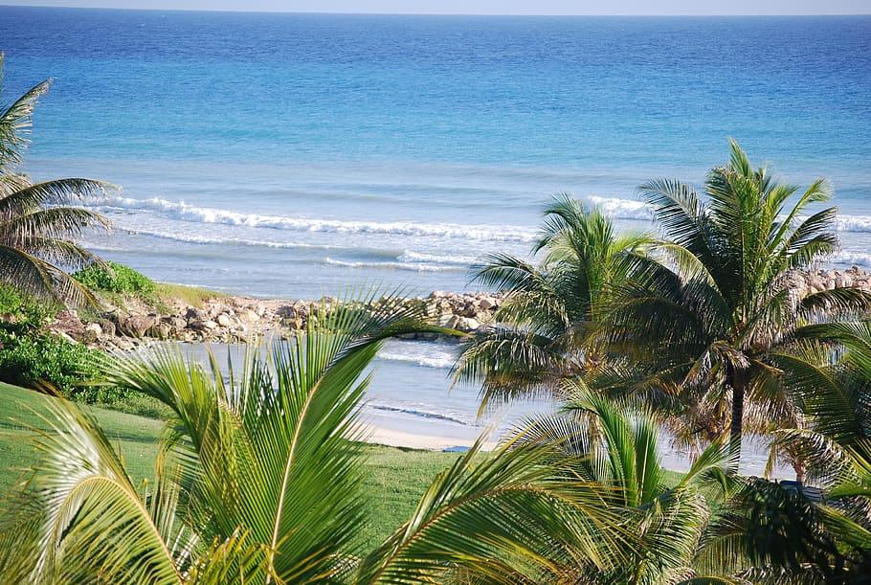
HOTEL DETAILS
DATE | NAME | ADDRESS | CITY | CONFIRM | ROOM | CHECK IN TIME | CHECK OUT TIME | MORE INFO
16 DECEMBER | SECRETS WILD ORCHID | F352+G4J Lot A59 Freeport, Montego Bay, Jamaica | MONTEGO BAY | 822457 JAM | 235 | 5:30AM UTC | 22 DEC 2024

Slide 10
ACTIVITIES
DATE | VENUE | STREET | CONTACT PERSON | ACT-TYPE | START TIME | END TIME | CITY | MORE INFO
16 DEC | SECRETS WILD ORCHID GOLF COURSE | A1 HIGHWAY | JADA | GOLF TOUR | 10M AM UTC | 3PM UTC | MONTEGO BAY
17 DEC | NEGRIL BEACH | MONTEGO HIGHWAY | MARLLY | JET CAR CRUISE | 10AM EAT | 1PM UTC | MONTEGO BAY
18 DEC | 9 MILES | A1 HIGHWAY | PETER | VISIT TO BOB MARLEY MUSEUM | 2PM UTC | 4PM UTC | MONTEGO BAY
19 DEC | NEGRIL COMMUNITY | A1 HIGHWAY | MARY | Rastafari Cultural ATV Community Experience from Negri | 1PM EAT | 6PM UTC | MONTEGO BAY
21 DEC | SECRETS WILD ORCHID | A1 HIGHWAY | JADA | SPA / FACIALS SESSION | 3PM UTC | 4:30PM UTC | MONTEGO BAY

Slide 11
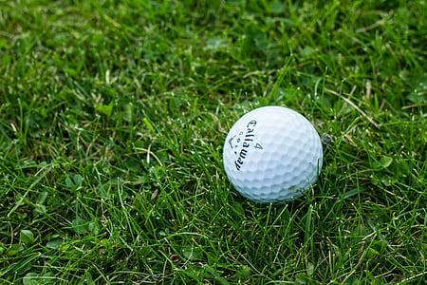
EVENTS
GOLF TOUR/TRAINING AT HALF MOON GOLF COURSE
VISIT HALFMOON GOLF COURSE FOR GOLF TOUR/TRAINING
DATE: 16 DECEMBER
TIME: 10AM UTC
ENDTIME: 3PM UTC

Slide 12
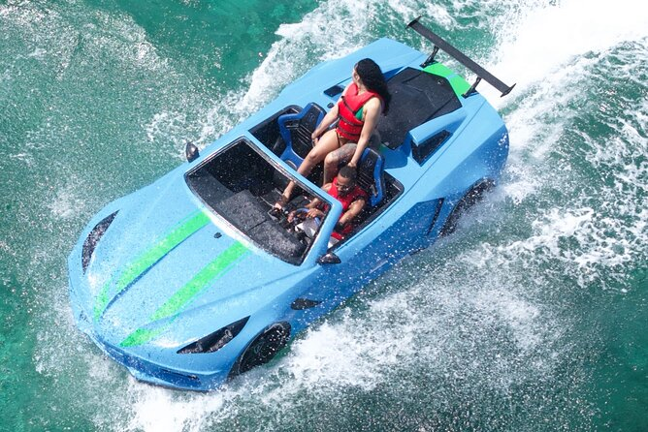

JET CAR CRUISE AT NEGRIL BEACH
VISIT NEGRIL BEACH FOR A JET CAR CRUISE WITH PRIVATE TRANSPORTATION
DATE: 17 DECEMBER
TIME: 10AM UTC
END TIME: 1PM UTC

Slide 13
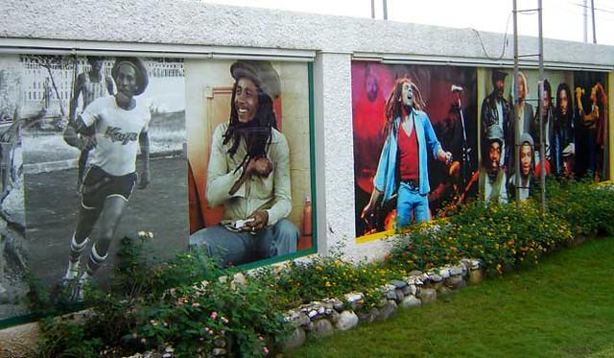

BOB MARLEY MUSEUM
VISIT BOB MARLEY MUSEUM FOR SIGHTSEEING
DATE: 18 DECEMBER
TIME:2PM UTC
END TIME: 4PM UTC

Slide 14
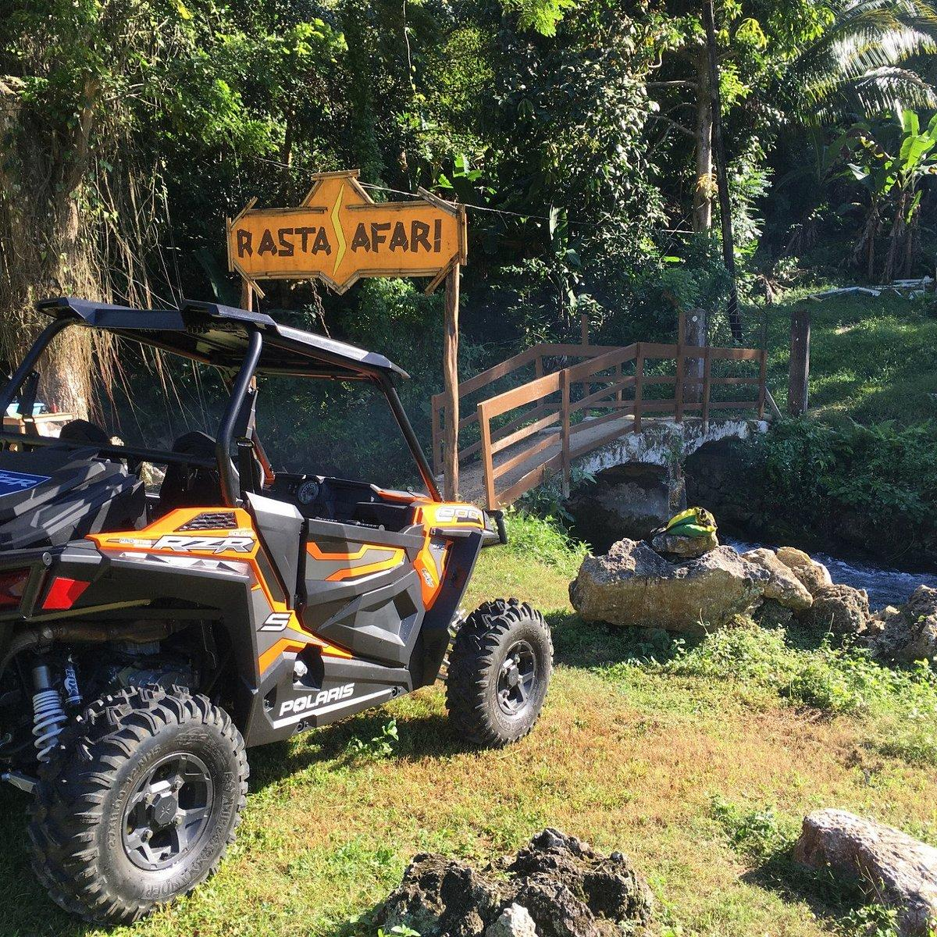
Rastafari Cultural ATV Community Experience
VISIT RASTAFARI CULTURAL ATV COMMUNITY
DATE:19 DECEMBER
TIME: 1PM UTC
END TIME: 6PM UTC

Slide 15
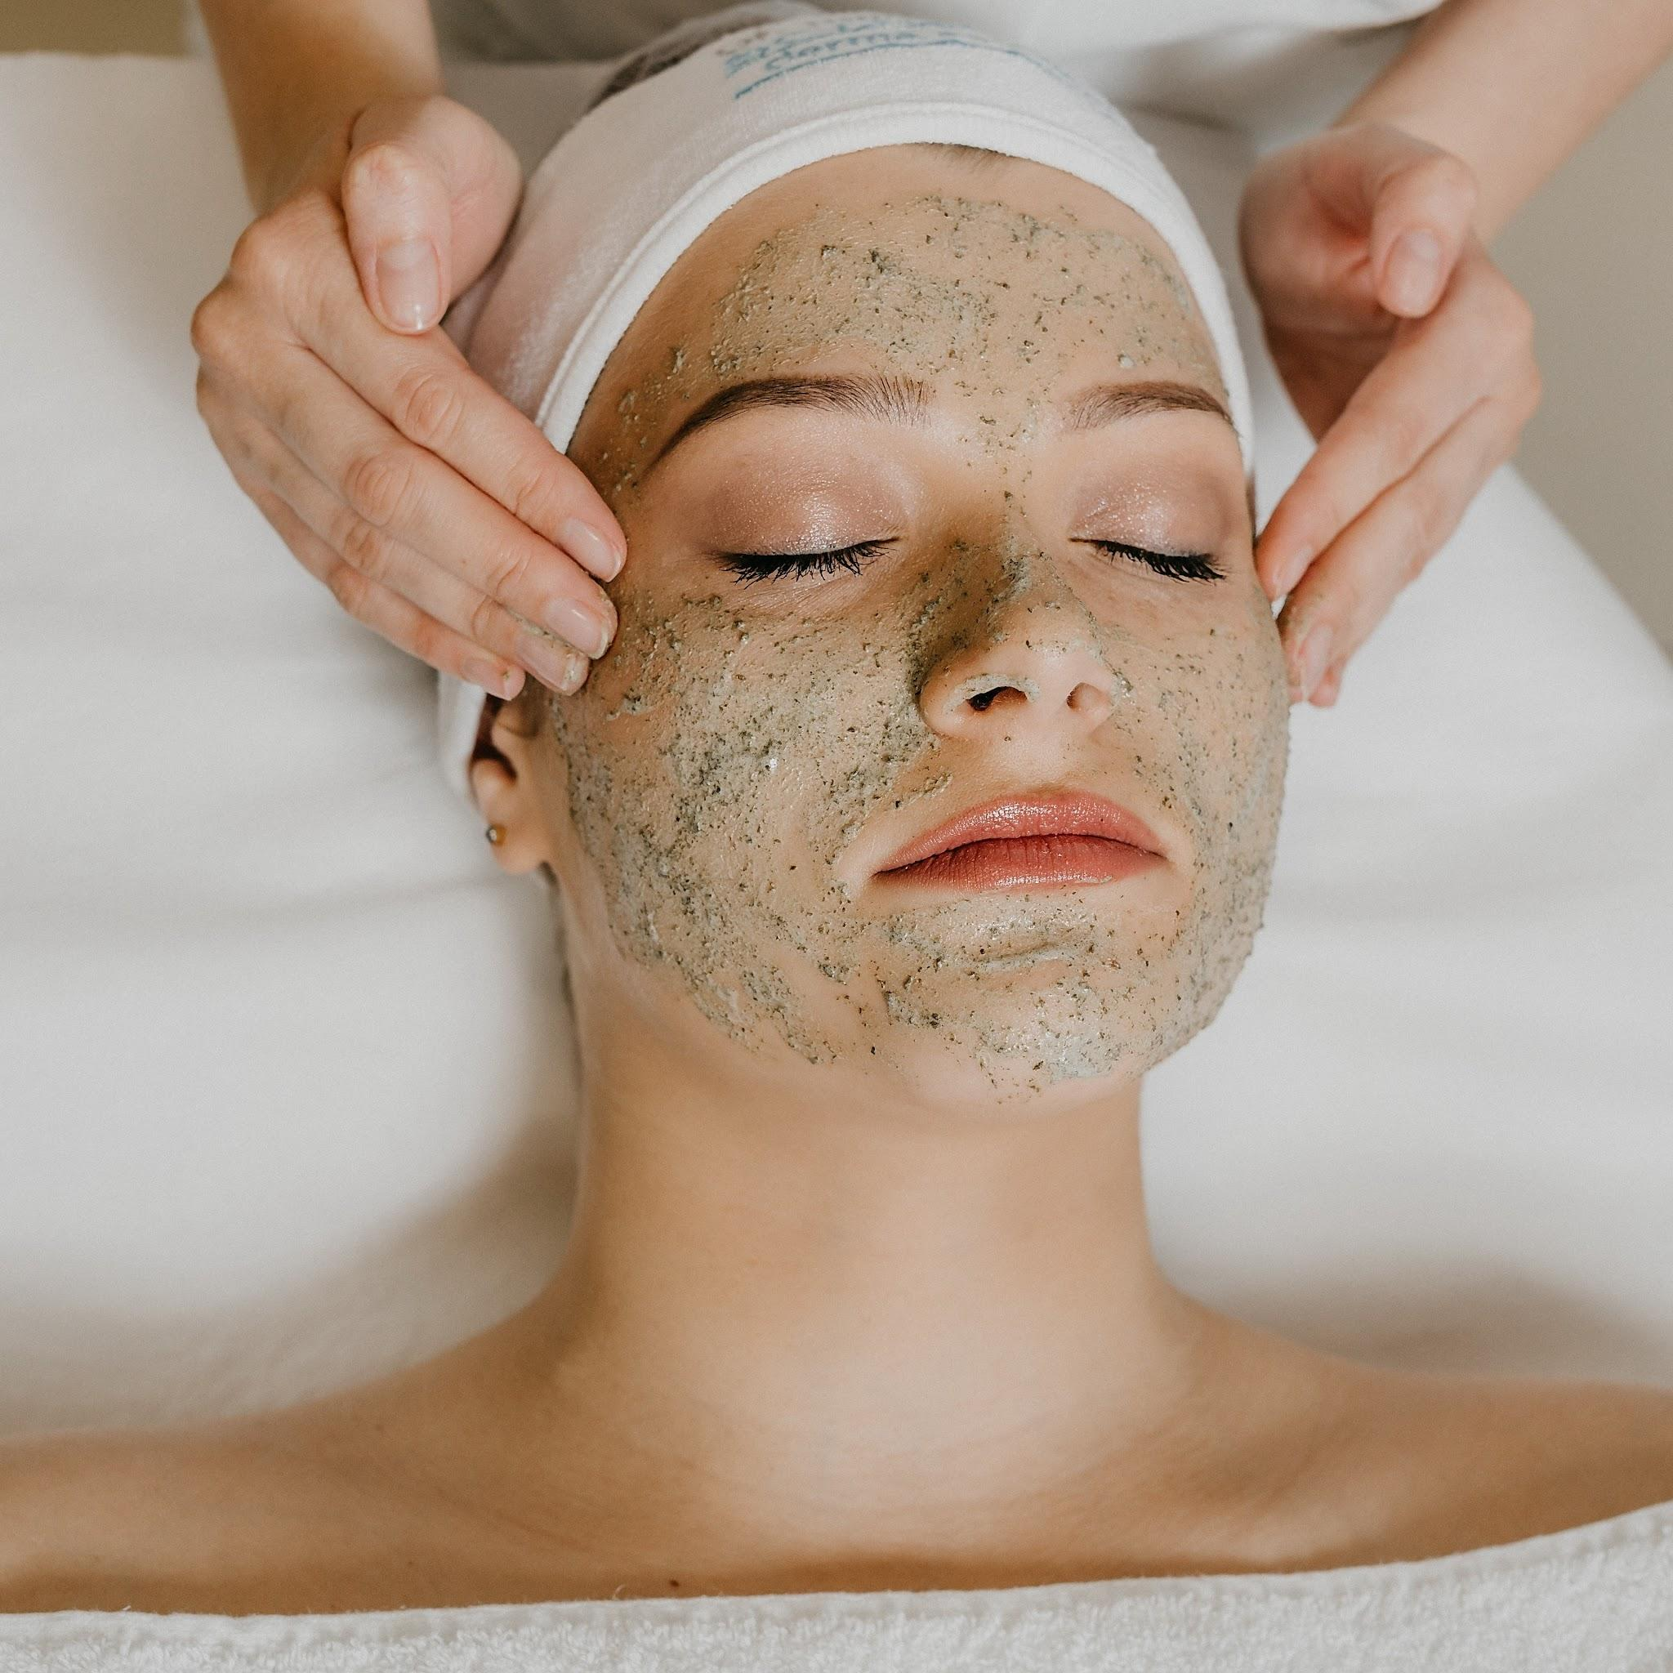
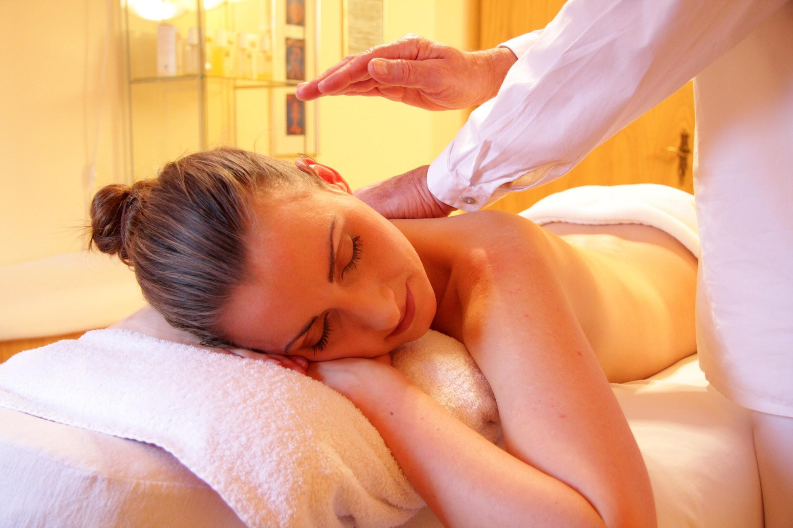
SPA / FACIALS SESSION
VISIT SECRETS WILD ORCHID SPA FOR MASSAGE AND FACIALS
DATE: 21 DECEMBER
TIME: 3PM UTC
END TIME: 6PM UTC

Slide 16

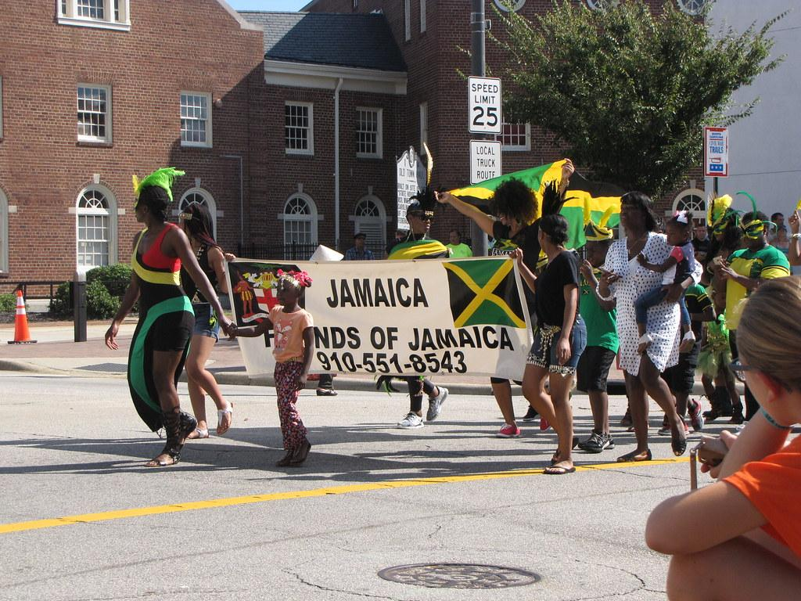
Etiquette and Cultural Expectations
You should always acknowledge a greeting by returning the greeting. When meeting someone for the first time, and in both social and formal circumstances, a firm handshake between men is the norm
Jamaicans do not cook on a Friday. All fast food joints were built for this purpose
Although Jamaicans are vivacious people, a conservative approach is best when socialising. Outlandish behaviour and public displays of affection are not taken to well, and you should be aware that certain homosexual acts are actually illegal.

Slide 17
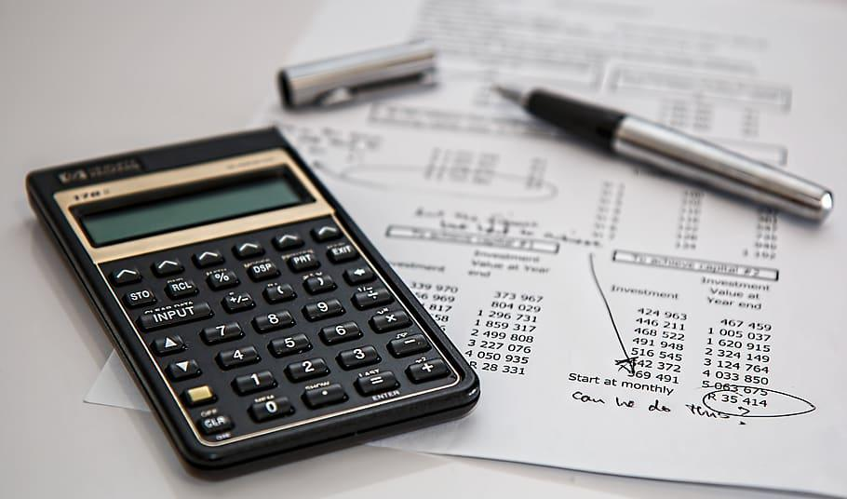
BUDGET
ITEMS | COST(USD)
VISA APPLICATION | $1000
FLIGHTS | $4000
ACCOMODATION | $9000
ACTIVITIES | $5000
MEALS | $12000
TOTAL | $31000

